Slide 1
Project Proposal: Utica Avenue Subway
An Analysis of Current Conditions & Our Proposal for Moving Forward
Black Mind

Slide 2
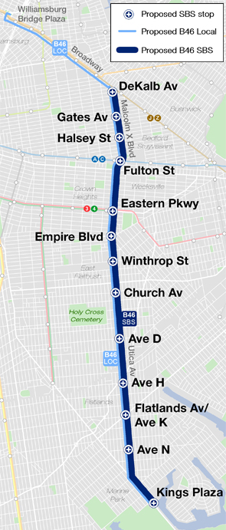
Site Background
Utica Avenue is a major avenue which runs north-south through Brooklyn, New York. This avenue currently runs primarily through the neighborhoods of Flatlands, East Flatbush and Crown Heights. According to the MTA, this corridor is one of the busiest in Brooklyn and carries around 44,000 people daily. This number does not include the informal methods of transportation used along the corridor.
Black Mind

Slide 3
Formal Options
The B46 bus runs primarily on Utica Avenue servicing much of the corridor north of Kings Plaza (a major shopping center in South Brooklyn).
However, due to high use, the SBS B46 bus route was recently added to increase efficiency along the route. This proved minimally effective in decreasing travel times for riders according to the Comptroller’s report. The report titled “The Other Transit Crisis: How to Improve the NYC Bus System” said improvements have only been logged at 1 mile per hour faster.
Black Mind

Slide 4
Informal Transportation
“Dollar vans” are commuter vans which run north-south along the Utica Ave corridor. They are understudied but are expected to have much faster travel times.
Charging $2 (as of 2020) per ride, this service has filled the gap of the MTA, yet was extensively criminalized for years. Despite this, during the pandemic, dollar vans have been recommended by the State as an alternative to formal modes of transportation.
Black Mind

Slide 5
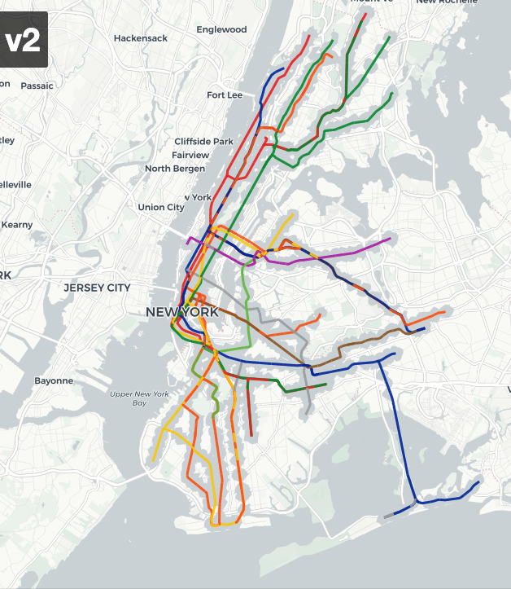
Brooklyn Transit Desert (BTD)
The Brooklyn Subway Desert is a term which refers to the sections of outer Brooklyn which, though within NYC jurisdiction, do not equally benefit from the NYC subway system.
The BTD starts at the Eastern Parkway station. It extends throughout Southeast Brooklyn. As a result, neighborhoods in this majority-black neighborhood are forced to spend increased money on transportation through purchasing cars.
Map of Current Subway Network with
neighborhoods located in the SE excluded from service
Black Mind

Slide 6
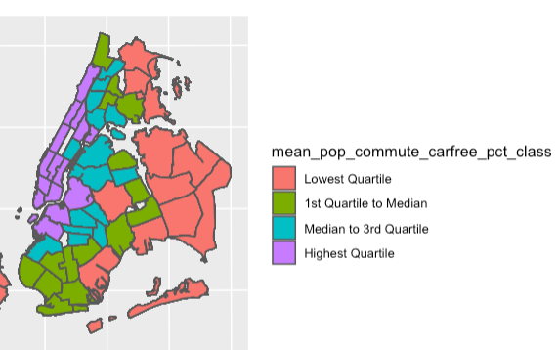
Car-free Travel
Percentage of Car-Free Travel by Neighborhood
Comparing the BTD to the map of car-free commutes by sub-boroughs shows that transit deserts rely more on cars. In fact, the regions nearest to transportation (East Flatbush), have higher rates of car-free commute. This suggests the entire area is being funneled towards the 2 & 5 Nostrand Line.
Therefore, the introduction of a Utica Avenue line would decrease Nostrand Line traffic by providing the region with an alternative. Additionally, induced demand should allow car-free travel to become more of an option for many residents.
Black Mind

Slide 7
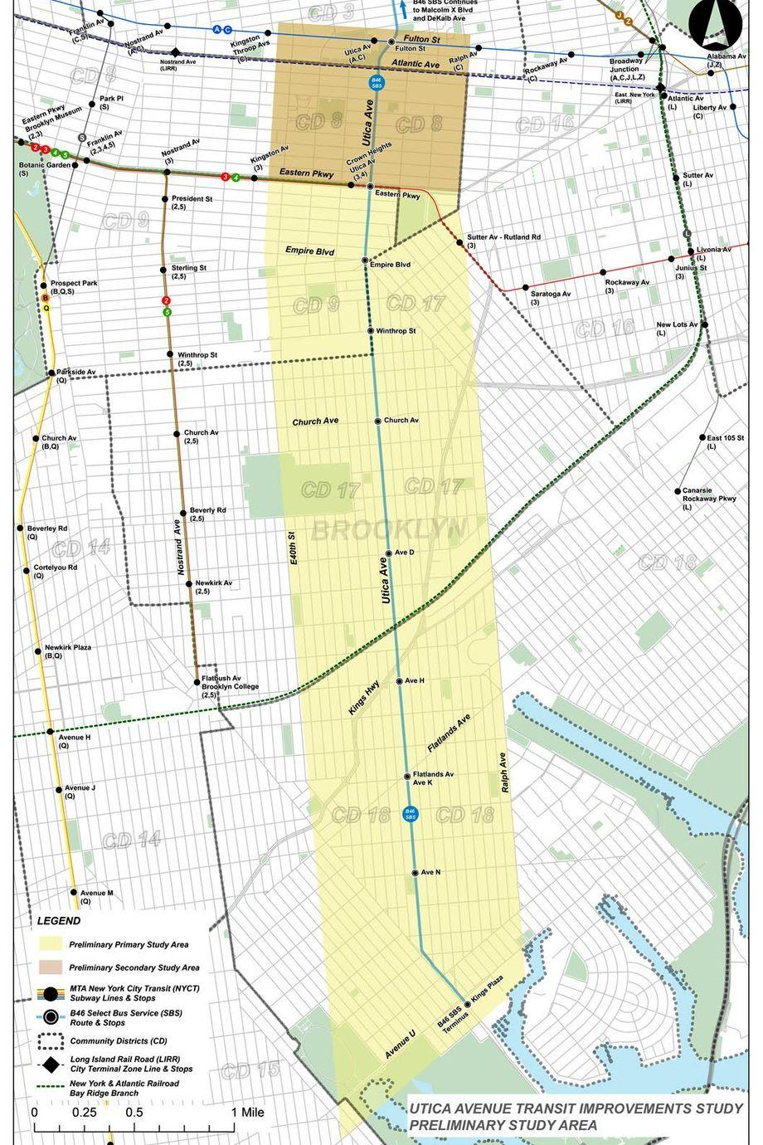
Utica Avenue As The Center of the BTD
This map shows the Utica Avenue corridor
Black Mind

Slide 8
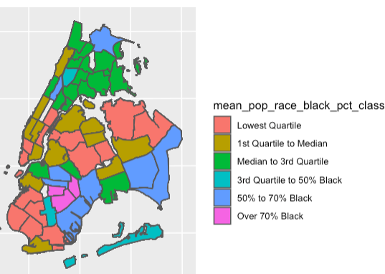
BTD overlaps with Black neighborhood
Percentage of Residents Which are Black by Neighborhood
Black Mind

Slide 9
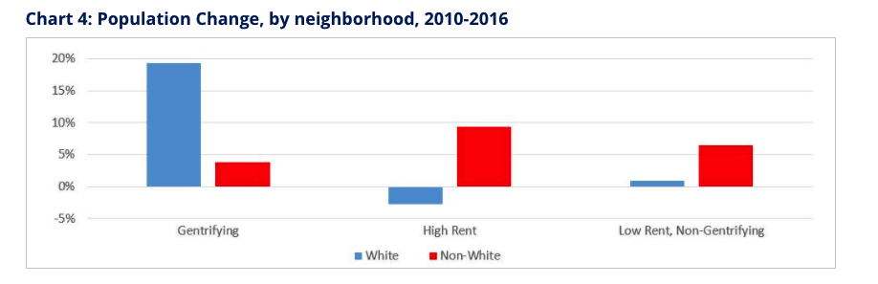
Community Concerns: Gentrification
In our discussions with the local Community Board (BK17), issues of increased gentrification as an issue arose in discussion. We acknowledge that any meaningful organizing must account for the larger political and economic forces at play. We want a study on the travel and economic behavior on this corridor to be completed by the MTA before any major plans.
This is also necessary to understand the effects on the informal economy.
Black Mind

Slide 10
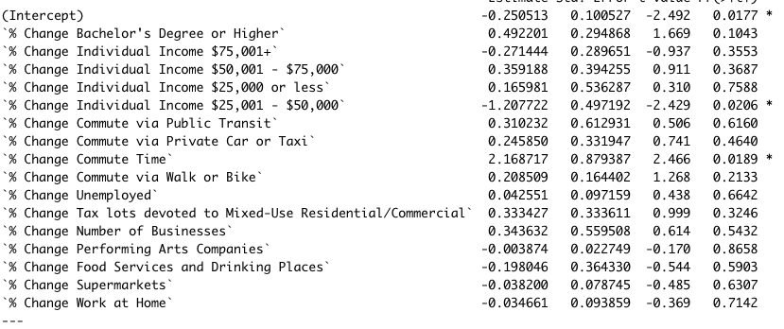
Displacement of Residents
Controlling for a number of other variables, we found change in commute time to be one of the major factors affecting the displacement of black residents over time. The relation between population change by race and commute time was only significant in black populations. Specifically, each 1 percent increase in average commute time per neighborhood was correlated with 2% increase in the percentage of Black residents in the neighborhood.
The data suggests that a decrease in commute time leads to a decline in residence particularly for black residents.
The effect was not significant for Hispanic and Asian residents. For white residents, the effect was the opposite.
Black Mind

Slide 11
Stopping Displacement
We propose setting up the Brooklyn Transit Desert as a displacement-free zone. A displacement-free zone would be the target of a community campaign intended to raise awareness about programs which protect tenants (and subsequently riders). The main program of concern is the Right to Counsel.
Black Mind

Slide 12
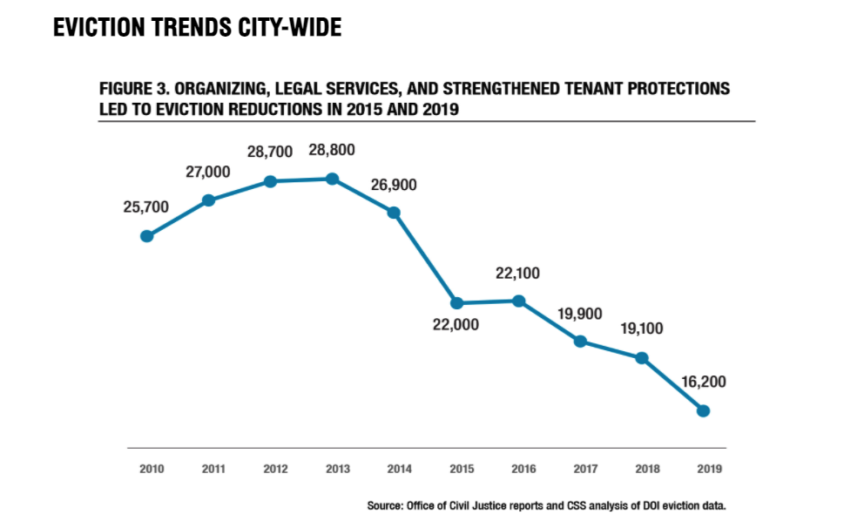
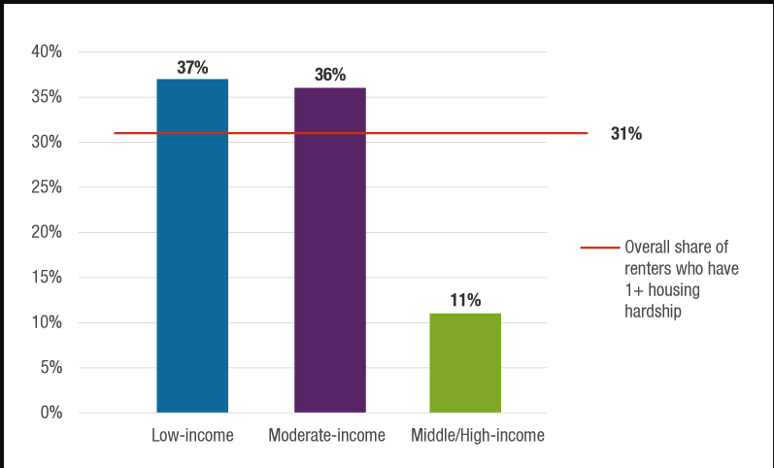
Trends in Evictions
Black Mind

Slide 13
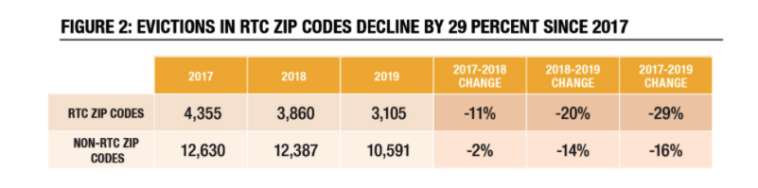
Evictions and Right to Counsel
For the past two years, Right to Counsel has been proven successful for 84 percent of those taken to court for eviction. This is a proven method which is decreasing evictions citywide as awareness of the program grows.
The city has realized it is often cheaper and more effective to provide legal counsel than put a family in a shelter.
Black Mind

Slide 14
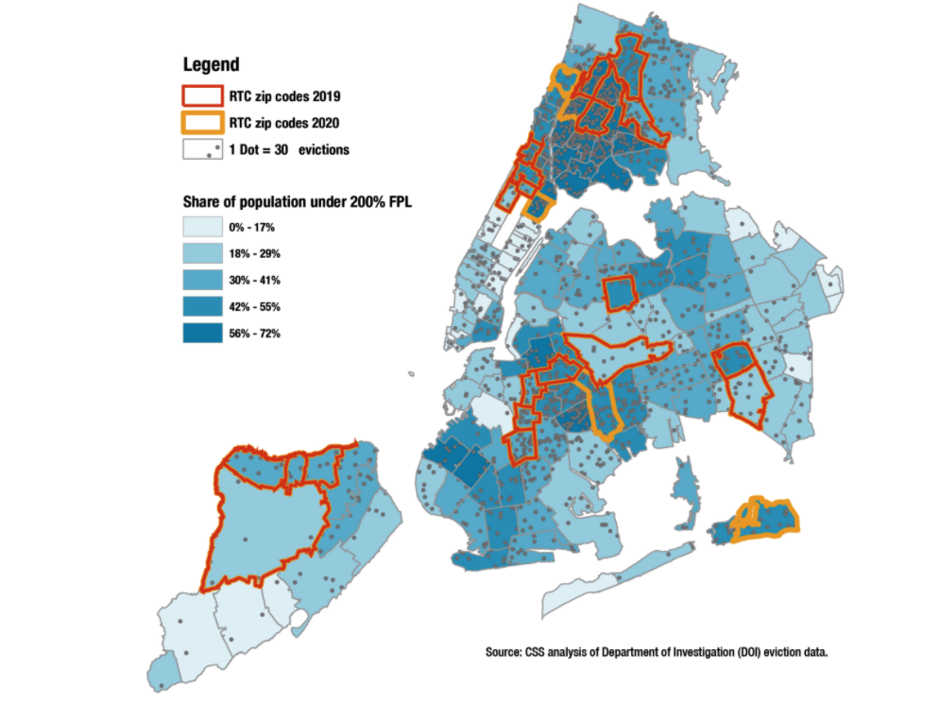
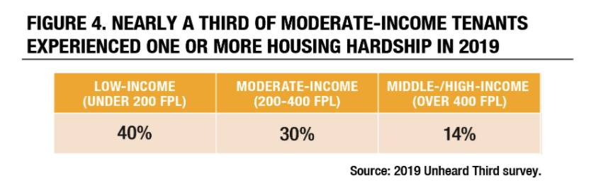
Implementation in BTD
The BTD will disproportionately benefit from the RTC zone expansion. This is because RTC will soon expand to moderate-income neighborhood, as well. Therefore, once full implementation of RTC is done in 2022, the lowering of evictions in the BTD should be drastic This provides an opportunity for sustainable, non-displacing transit-oriented development such as the Utica Avenue Subway.
Black Mind

Slide 15
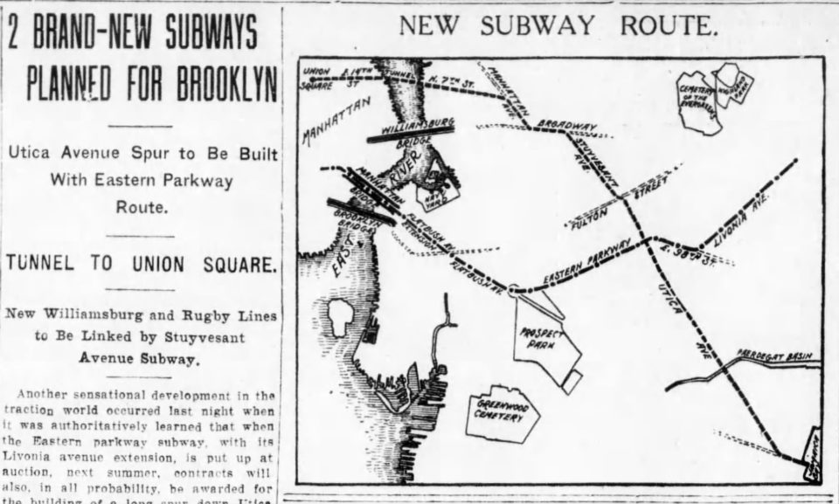
Conclusion
This project has been ignored for over 100 years by the MTA. There are valid concerns of gentrification from the community. However, the right to counsel initiatives show a rare opportunity for transit-oriented development with sufficient safeguards in place to stop high displacement. The current political climate and push for infrastructure provides a window of opportunity to expand service to majority-minority communities citywide.
Therefore, we propose the development of advocacy through testimonials, videos, pictures, flyer, and meetings with local politicians to put this issue on the radar of NYC officials and communities. Specifically, the $10M allocated for studying the extension since 2015 must finally be used and completed with social, economic, and environmental aspects considered (both formally and informally recognized).
The message must be clear that sustainable and economically beneficial development is possible and we can no longer ignore issues of equity in the allocation of transit resources.
Plans for Utica Avenue Subway (Circa 1920)

